Slide 1

Healthcare Analytics For Doctor Visit TIRTC
~Shraddha Kharade
AICTE ID : STU6832ab424991f1748151106

Slide 2

PROBLEM STATEMENT
Healthcare organizations generate large amounts of patient and healthcare-utilization data. However, analyzing this data manually can make it difficult to understand the factors associated with doctor visits.
This project focuses on analyzing healthcare data to:
Understand patterns in doctor visits
Study the relationship between health conditions and visits
Analyze the impact of age, gender and income
Examine illness and reduced activity
Identify useful patterns from healthcare data
Support data-driven healthcare analysis

Slide 3
Healthcare Analytics for Doctor Visits is a data analytics project that explores patterns in doctor visits using Python.
The project uses a dataset containing 5,190 records and 13 variables.
The analysis includes:
Data loading and exploration
Dataset structure analysis
Statistical summary
Missing-value checking
Univariate analysis
Relationship analysis between variables
Visualization of doctor-visit patterns
Project Description

Slide 4

WHO ARE THE END USERS?
            Hospitals and Healthcare Organizations
            Doctors and Healthcare Professionals
            Healthcare Data Analysts
            Healthcare Administrators and Planners
            Researchers and Students

Slide 5

Technology Used
Programming Language
Python
Libraries
  Pandas
  NumPy
  Matplotlib
  Seaborn
Environment
Google Colab

Slide 6
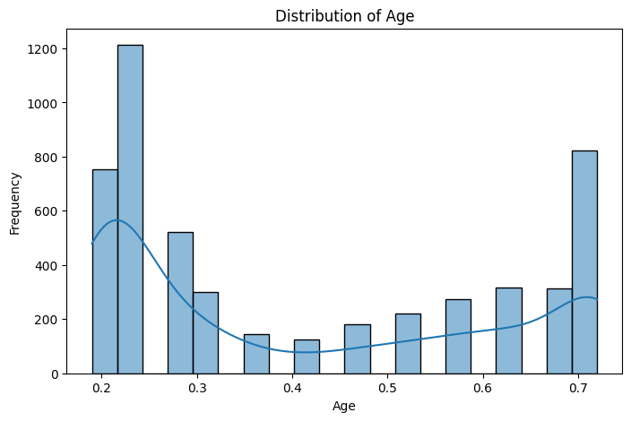
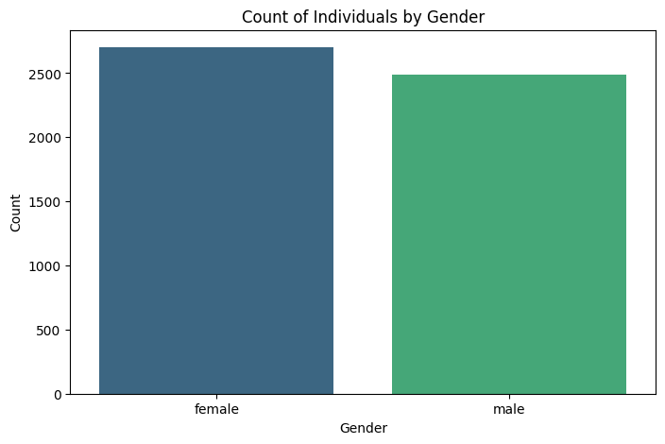
RESULTS
https://github.com/shraddhakharade126/Healthcare-Analytics-for-Doctor-Visits_VOIS_DIY_Project.git

Slide 7
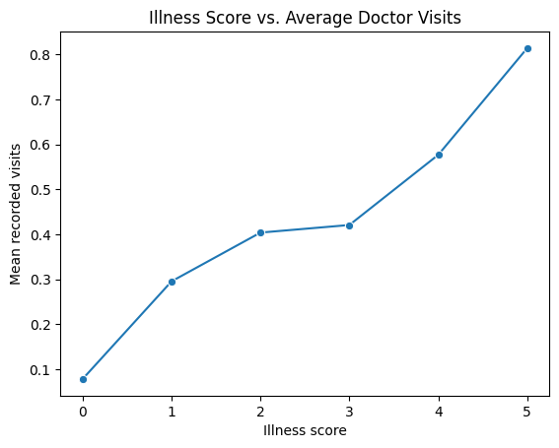
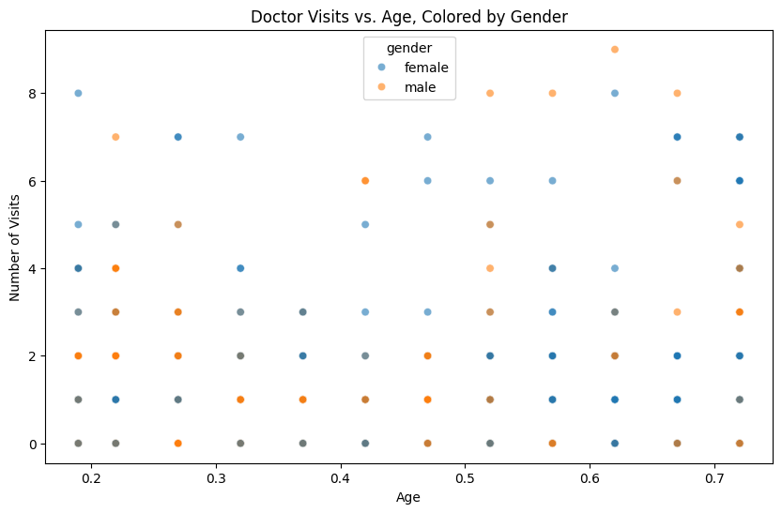
RESULTS
https://github.com/shraddhakharade126/Healthcare-Analytics-for-Doctor-Visits_VOIS_DIY_Project.git

Slide 8
Thank you
.
.

